Slide 1
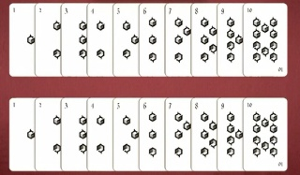




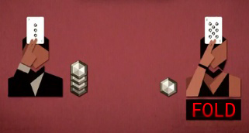
1. The game starts with 2 sets of cards (1~10).
2. Each player will be given one of them.
3. They do not know what they have. The system shows only their counterparts’ card.
4. They start betting chips.
5. When the numbers of chips that they bet become the same, the game finishes and a player who has a higher number wins.
6. Players can give up the game when they assume that they might lose.

Slide 2
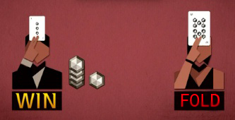
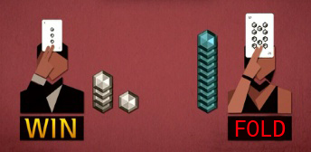
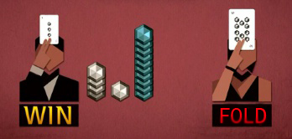

7. If a player who has a number 10 card gives up, the player will lose double amount of chips that the players bet.
8. Once a player obtains all chips that its counterpart has, the final game finishes. Then, a winner can exchange the chips for garnets.

